Slide 1
Figure 1 new version 0227

Slide 2
Steps
1. find three real RNAs, plot them in 2D plots.
2. Draw an intact sample plot accordingly
3. build a bar plot for the most abundant RNA sequence
4. ladder assembly in PPT.
5. Draw an intact sample with only low intensity RNAs remaining.
6. Produce sequence output.

Slide 3
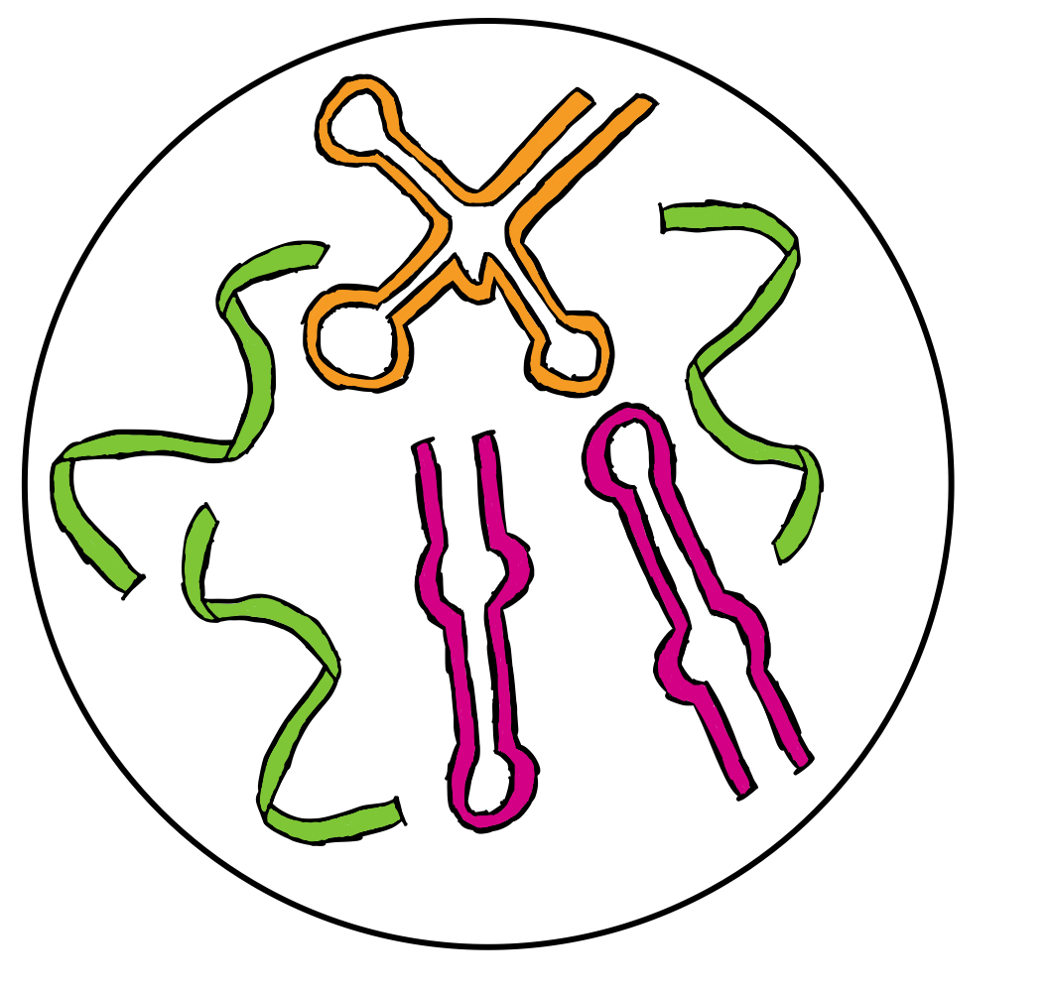
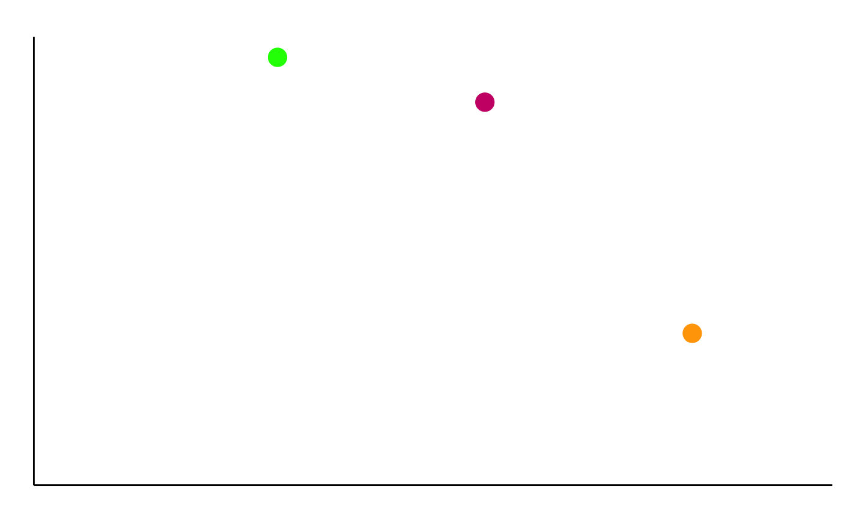
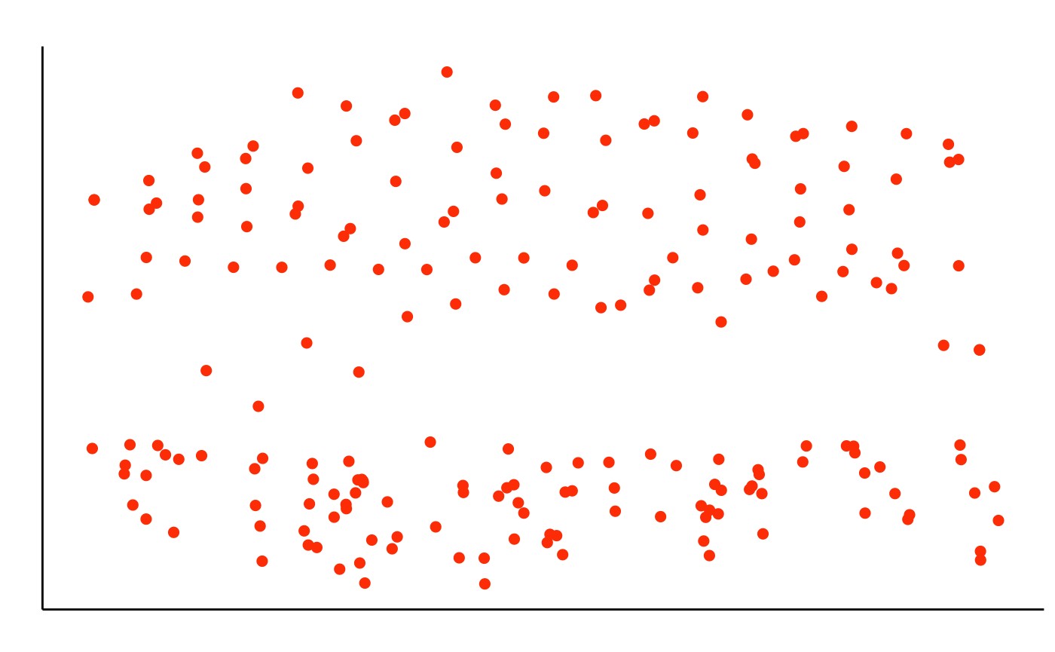
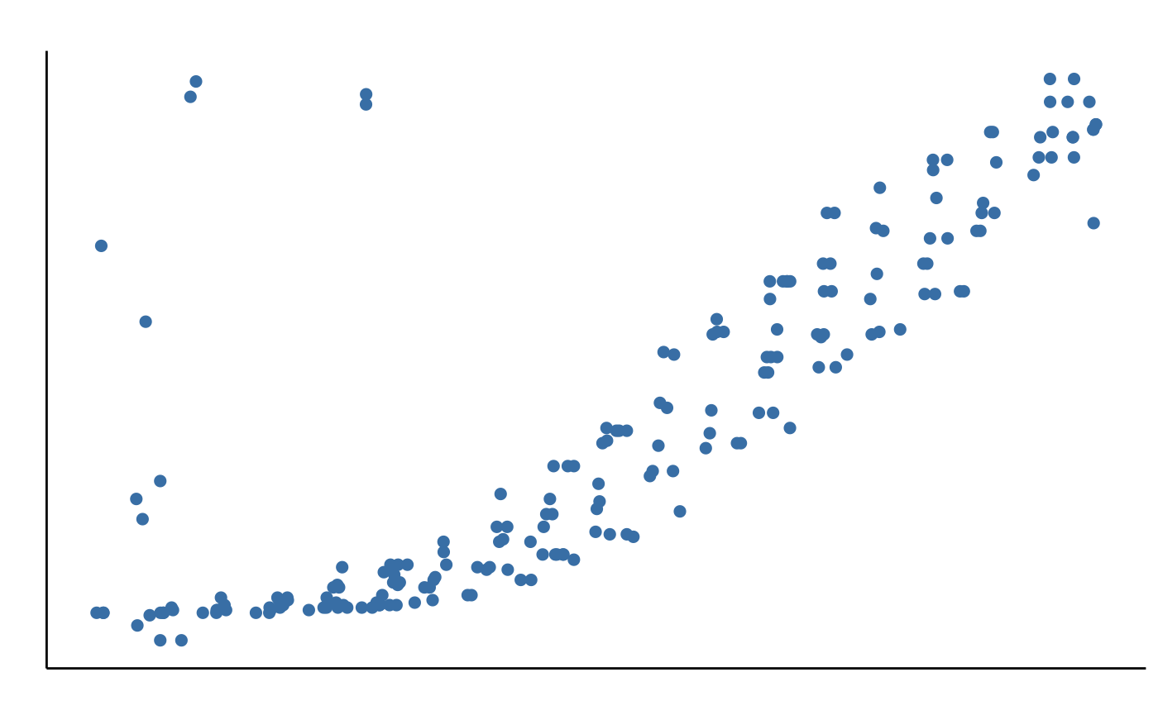
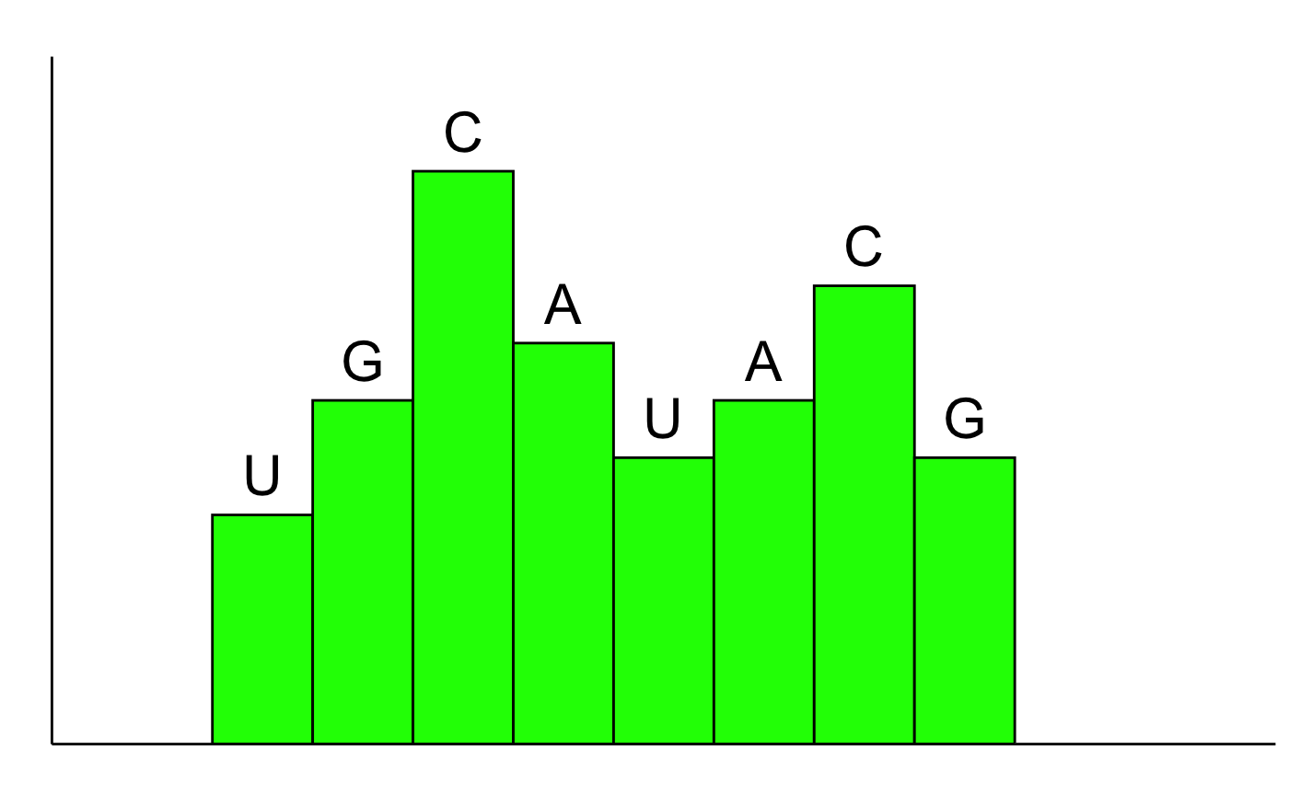
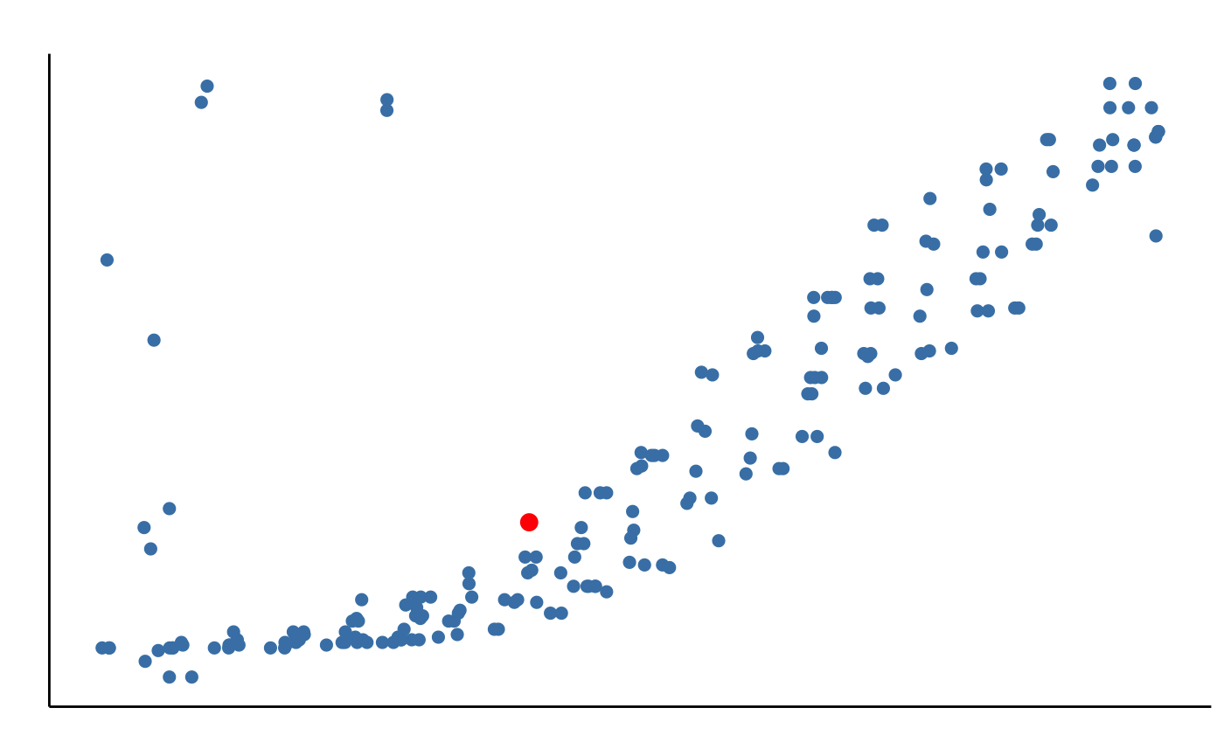
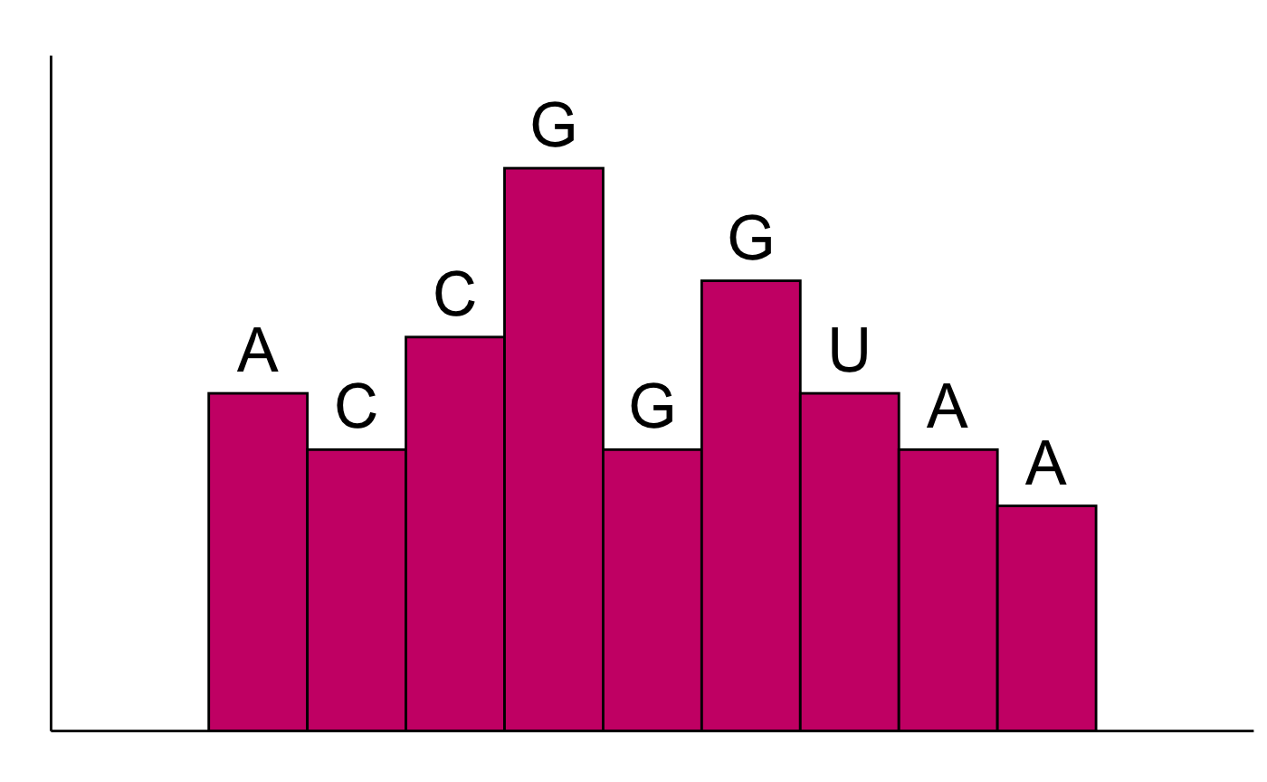
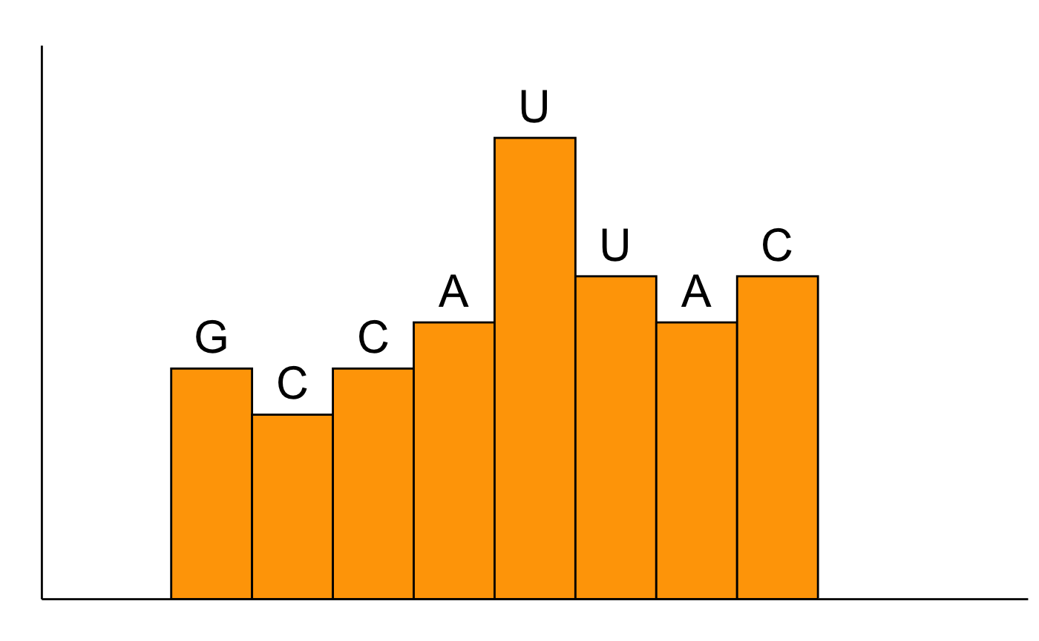
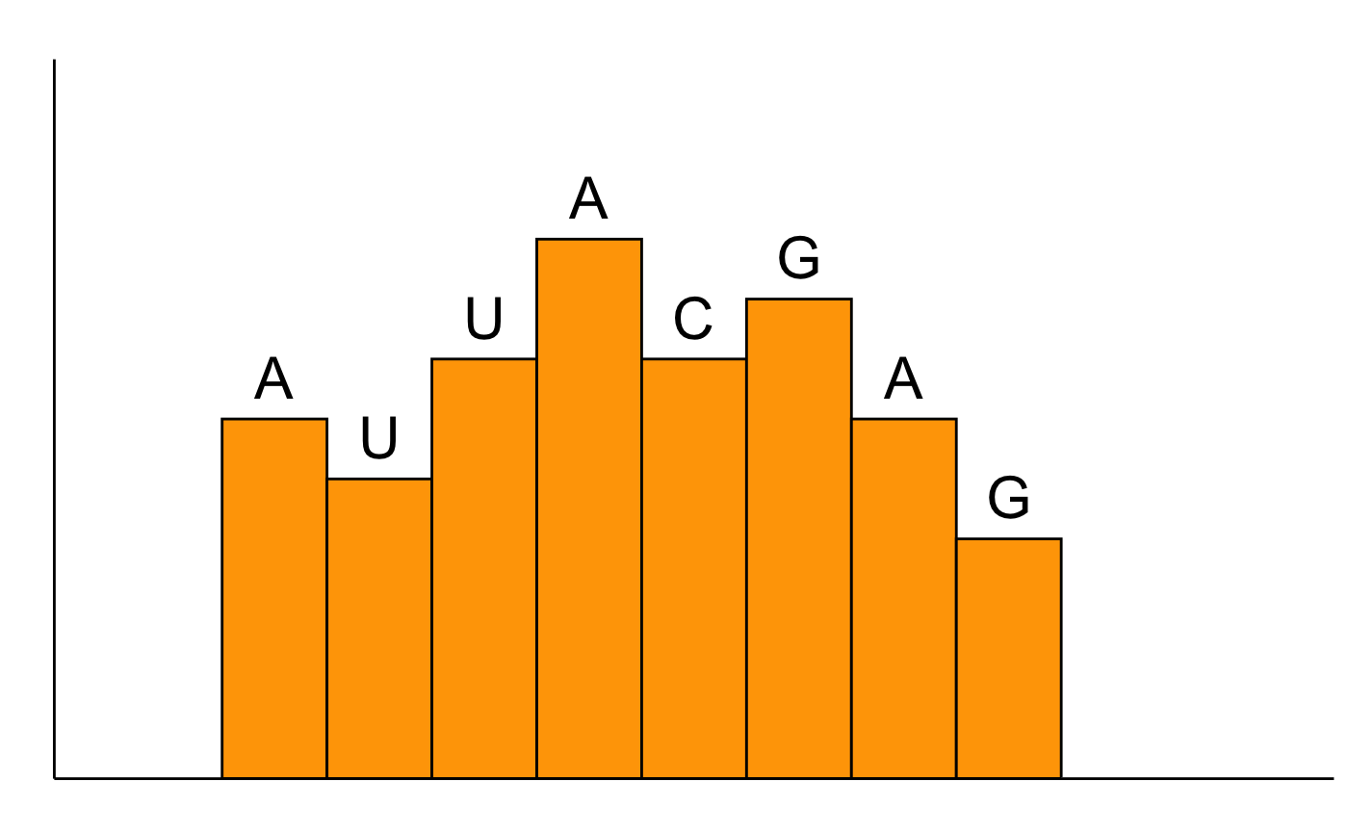
SI
① No acid hydrolysis treatment
Determine number of RNAs and their sum intensity in the sample respectively
LC-MS
Mass
SI
t_{R}
② Controlled acid hydrolysis
+
LC-MS
mixture of RNAs with different abundances
Mass
Mass
Ladder #1
③ Start base calling from the mass point with highest sum intensity in the dataset
SI
t_{R}
G
④ Generate RNA ladder
C
A
U
Ladder position
C
A
SI
Ladder #2
G
U
Repeat steps ③&④ to generate more ladders
: mass point with highest sum intensity in the dataset
Mass
Ladder position
SI
Ladder #3
Ladder #1:
U
G
C
A
U
A
C
G
5’ 3’
⑥ Final Sequence Output
Most abundant RNA sequence: UGCAUACG
2nd most abundant RNA sequence: ACCGGGUAA
3rd most abundant RNA sequence: GCCAUUACGAG
......
Ladder #2:
A
C
C
G
G
G
U
A
A
⑤ Assemble ladders
5’ 3’
Ladder position
Ladder #3:
G
C
C
A
U
U
A
C
Ladder #4
5’ 3’
SI
Ladder #4:
A
U
U
A
C
G
A
G
5’ 3’
Ladder position

